Slide 1

A Comparative Guide to Relational and Non-Relational Databases
KEY FEATURES AND BENEFITS
WILLIAMS BOLUWATIFE
27th DECEMBER 2024

Slide 2
INTRODUCTION
A database is a collection of interrelated data that is stored, retrieved, and collected in a single location. A database is a collection of data saved on a computer.
A Database Management System (DBMS) is a collection of interconnected data and a set of software tools/programs for accessing, processing, and manipulating data.
Database management systems (DBMS) provide a number of benefits, including improved data security, integration, abstraction, data redundancy reduction, data sharing, data consistency and accuracy, data organisation, and rapid data access and retrieval. Data security is critical in the corporate world, as companies make significant investments in data protection.
DBMS delivers well-managed and synchronised data, which simplifies data management and provides an integrated perspective of an organisation.
In the area of database management, the data is arranged in two ways which are Relational Databases (SQL) and Non-Relational Databases (NoSQL). This powerpoint will focus on key characteristics of these models and their differences.

Slide 3
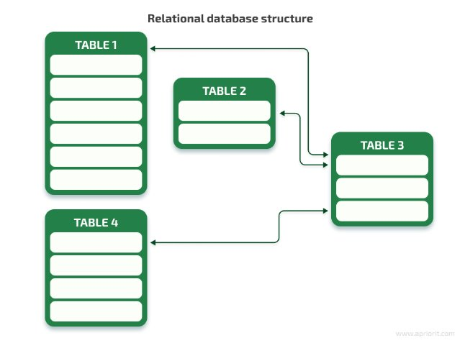
RELATIONAL DATABASE
A relational database uses a structure that allows us to identify and access data in relation to another piece of data in the database. Often, data in a relational database is organized into tables
The table represents an object or entity while the column represents the type of data that can be stored in the respective column
KEY CHARACTERISTICS OF RELATIONAL DATABASE
Data is represented in rows and columns called relations.
Data is stored in tables having relationships between them called the Relational model.
The relational model supports the operations like Data definition, Data manipulation, and Transaction management.
Each column has a distinct name, and they represent attributes.
Each row represents a single entity.

Slide 4
RELATIONAL DATABASE CONT'D
KEY CHARACTERISTICS OF RELATIONAL DATABASE
SQL (Structured Query Language) is the most common way of interacting with relational database systems. Developers can use SQL queries to execute CRUD (Create, Read, Update, Delete) operations.
There can only be a single schema or structure for the data within a relational database.
ADVANTAGES OF RELATIONAL DATABASE
Relational model complies with ACID: Atomicity, Consistency, Isolation, and Durability (ACID) is a standard that guarantees the reliability of database transactions. The general principle is if one change fails, the whole transaction will fail, and the database will remain in the state it was in before the transaction was attempted. This is important because some transactions will have real consequences if not completed fully—for example, banking.
Data Accuracy: Using main and foreign keys ensures that there is no duplicate information. This enforces data accuracy because there will never be repeated information.
Normalization: Normalization is the process of organising data so that data anomalies are decreased or removed. This, in turn, lowers storage expenses.

Slide 5
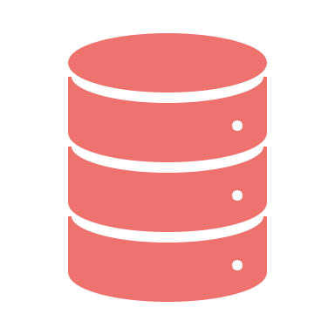
RELATIONAL DATABASE CONT'D
ADVANTAGES OF RELATIONAL DATABASE
Simplicity: SQL databases, have been around for so long that a wide range of tools and resources have been created to assist in getting started and interacting with relational databases. SQL's English-like syntax allows non-developers to construct reports and queries from the data.

Slide 6
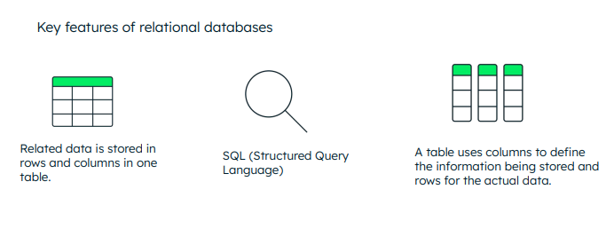
Source: MONGO1.png (692×258)

Slide 7
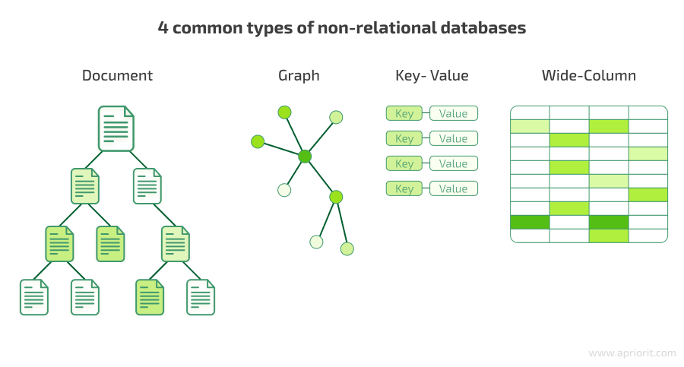
NON-RELATIONAL DATABASE
A non-relational database, sometimes called NoSQL (Not Only SQL), is any kind of database that doesn’t use the tables, fields, and columns structured data concept from relational databases.
Instead, non-relational databases may be built on data structures such as documents.
Non-Relational Database Types
There are four main types of non-relational databases:
Key/value
Graph
Column
Document.

Slide 8
NON-RELATIONAL DATABASE CONT'D
Non-Relational Database Management Systems
Some of the popular Non-Relational Database Management Systems are:
MongoDB, Apache Cassandra, Redis, Couchbase, Apache HBase, Neo4j, Riak, Aerospike, Orient DB, Arango DB.
KEY CHARAECTERISTICS
Non-Relational Structure: NoSQL databases store data in flexible formats like key-value pairs, documents, or graphs, allowing for easier adaptation to changing data needs.
Scalability: It is Designed for horizontal scaling across several servers, enabling effective handling of enormous data volumes and rapid transaction rates.
High Performance: It is highly optimised for specific query types and workloads, focusing on low latency and high throughput.
Flexibility in Data Models: It Supports various data structures (e.g., documents, columns, graphs) to fit diverse application requirements without rigid schemas.
Horizontal Partitioning: It distributes data among several nodes using sharding, which enhances performance and facilitates the effective management of big datasets.

Slide 9
NON-RELATIONAL DATABASE CONT'D
ADVANTAGES OF NON-RELATIONAL DATABASE
Scalability: Non-relational databases such as Cassandra and MongoDB are made to expand horizontally across groups of inexpensive commodity hardware, providing smooth scalability as user loads and data volumes rise.
Flexibility: Non-relational databases facilitate the storage and management of unstructured or semi-structured data by supporting flexible data models such as document stores (like JSON in MongoDB), key-value pairs (like Redis), and wide-column stores (like Cassandra), in contrast to relational databases' inflexible table-based structures.
High Performance: Non-relational databases excel in real-time data ingestion, high-speed transactions, and rapid access to large volumes due to their distributed architecture and optimized data storage formats.
Schemaless Design: Non-relational databases enable developers to adapt their data structure without downtime or complex migrations, making them ideal for agile development and handling diverse data types.
Cost-Effectiveness: Non-relational databases, which utilize commodity hardware and open-source software, often offer a more cost-effective solution compared to traditional relational databases, particularly at scale.

Slide 10
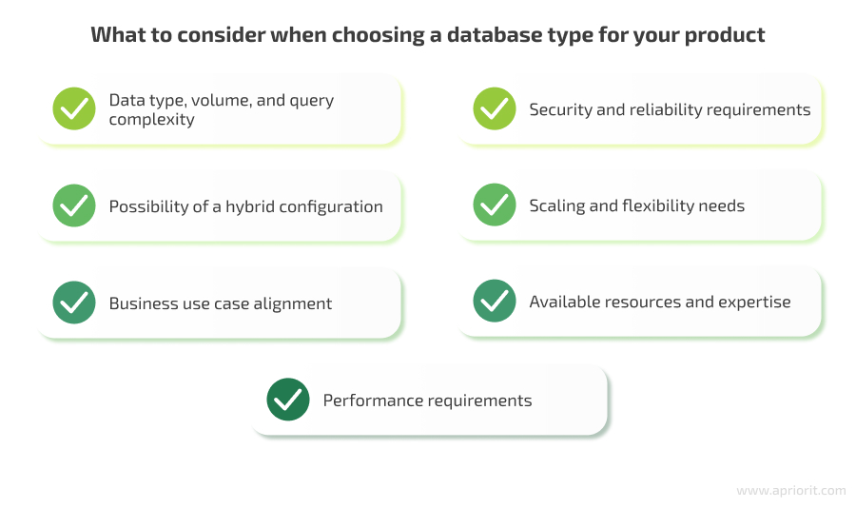
WHEN TO USE RELATIONAL AND NON-RELATIONAL DATABASE
For projects where the shape, size, and frequency of access to the data are predictable, relational databases continue to be the best option. by reducing duplicate data and anomalies, normalization can help reduce the amount of data on disc and lessen the risk of future vertical scaling. If relationships between entities are significant, relational databases are also the best choice.
Non-relational databases can store documents within documents, keeping data that will be accessed together in one place. However, if this does not meet your requirements, a relational database remains the best option. For example, if you have a large dataset with complicated structure and linkages, embedding may not produce sufficiently apparent links.
Non-relational databases come in a variety of forms, each with unique benefits and drawbacks,, nevertheless, they continue to offer certain reliable benefits. A non-relational database is the best option if the data you are storing must be flexible in terms of size or shape or if it may change in the future.
Modern NoSQL databases are naturally suited for horizontal scalability, which enables numerous smaller servers to be spun up to accommodate increasing loads, because they were designed with the cloud in mind.

Slide 11
RELATIONAL DATABASE VS NON-RELATIONAL DATABASE
FEATURES | RELATIONAL DATABASE | NON-RELATIONAL DATABASE
DATA STRUCTURE | Tables with rows and columns | Various formats (document, key-value, columnar, graph)
SCHEMAS | Structured schema enforced by schemas | Flexible schema, often schema-less or dynamic
QUERY LANGUAGE | SQL (Structured Query Language) | Query languages specific to the database type (e.g., JSON query languages, graph traversal languages)
ACID COMPLIANCE | ACID transactions | May vary; some offer ACID compliance, others eventual consistency
SCALABILITY | Vertical and horizontal scaling options | Horizontal scaling typically easier and more flexible
FLEXIBILITY | Less flexible with rigid schema definitions | Highly flexible due to schema-less or dynamic schema
PERFORMANCE | Excellent for complex queries and joins | Optimal for hierarchical data storage and retrieval
EXAMPLES | MySQL, PostgreSQL, SQL Server | MongoDB, Cassandra, Redis, DynamoDB

Slide 12

CONCLUSION
In conclusion, the type of data and the application's needs play a major role in the decision between relational and non-relational databases. In structured data systems where complex querying and data integrity are critical, relational databases perform exceptionally well. Conversely, non-relational databases excel in situations requiring high performance across dispersed systems, scalability, and flexibility in data models.

